Slide 1
Control flow statements and Boolean expression

Slide 2
Boolean Expression
Computes logical values for flow of control statements
Boolean operator
and, or, not
Relational operators
< , >, <=, >=, ==, !=

Slide 3
Syntax Directed Translation
Production | Semantic Rule
E → E1 or E2 | E.place := newtemp emit( E.place ‘:=‘ E1.place ‘or’ E2.place)
E → E1 and E2 | E.place := newtemp emit( E.place ‘:=‘ E1.place ‘and’ E2.place)
E → not E1 | E.place := newtemp emit( E.place ‘:=‘ ‘not’ E1.place)
E → (E1) | E.place = E1.place

Slide 4
Production | Semantic Rule
E → id1 relop id2 | E.place := newtemp emit (if id1.place relop.op id2.place, goto nextstat + 3) emit (E.place := 0) emit (goto nextstat+2) emit (E.place :=1)
E → true | E.place = newtemp emit(E.place ‘:=‘ 1)
E → false | E.place = newtemp emit(E.place ‘:=‘ 0)

Slide 5
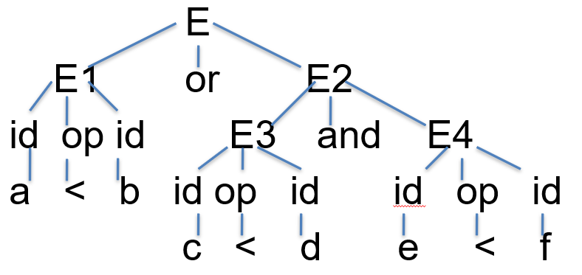
Example
a < b or c < d and e < f
E => E1 or E2 => E1 or E2 and E3

Slide 6
Three address code
108 if e < f goto 111
109 t3 := 0
110 goto 112
111 t3 := 1
112 t4: = t2 and t3
113 t5 := t1 or t4
100 if a < b goto 103
101 t1 := 0
102 goto 104
103 t1 := 1
104 if c < d goto 107
105 t2: = 0
106 goto 108
107 t2:= 1

Slide 7
Short Circuit code
Boolean expression – 3 address code without generating code for boolean operators
Need not evaluate the full expression

Slide 8
Example
E – a > b
Then code is
if a > b goto E.true
goto E.false
This is different from creating a temporary variable and assigning it 0 / 1

Slide 9
Short circuit information
If E is of the for E1 or E2, then if E1 is true, then this can directly be associated to E.true.
If E1 is false then E2 need to be evaluated

Slide 10
SDD for 3-address code for boolean
Production | Semantic Rule | Inference
E → E1 or E2 | E1.true := E. true E1.false := newlabel E2.true := E.true E2.false := E.false E.code := E1.code || gen (E1.false ‘:’) ||E2.code | Instead of creating newlabel, we directly assign it to E.true
E → E1 and E2 | E1.true := newlabel E1.false := E.false E2.true := E.true E2.false := E.false E.code := E1.code || gen (E1.true ‘:’) || E2.code

Slide 11
Production | Semantic Rule | Inference
E → not E1 | E1.true := E. false E1.false := E.true E.code := E1.code
E → (E1) | E1.true := E. true E1.false := E.false E.code := E1.code
E → id1 relop id2 | E.code := gen (‘if’ id1.place relop.op id2.place ‘goto’ E.true) || gen (‘goto’ E.false)
E→ true | E.code := gen (‘goto’ E.true)
E → false | E.code := gen (‘goto’ E.false)

Slide 12
Example - a < b or c < d and e < f

Slide 13
Interpretation - a < b or c < d and e < f
E1.true = E.true
false label for E1
true label for E3
E3’s false is E2’s false and E’s false
E4’s true is true for E
E4’s false is E’s false

Slide 14
Code- a < b or c < d and e < f
if a < b goto Ltrue
goto L1
L1: if c < d goto L2
goto Lfalse
L2: if e < f goto Ltrue
goto Lfalse

Slide 15
Flow of control statements
All these statements “E” corresponds to a Boolean expression evaluation
This expression E should be converted to three address code as already discussed
This is then integrated in the context of control statements

Slide 16
Flow of Control Statements
Boolean expressions are typically used along with if-then, if-then-else, while-do statement constructs
S → if E then S1 | if E then S1 else S2 |
while E do S1 | do S1 while E

Slide 17
if-then statement
Label | Control flow
 | E.code
E.true: | S1.code
E.false:
To E.true
To E.false

Slide 18
Syntax directed definition for if-then
Production | Semantic Rules
S → if E then S1 | E.true:= newlabel E.false := S.next S1.next := S.next S.code := E.code || gen (E.true’:’) || S1.code

Slide 19
if-then-else statement
Label | Control flow
 | E.code
E.true: | S1.code
 | goto S.next
E.false: | S2.code
S.next
To E.true
To E.false

Slide 20
SDD for if-then - else
Production | Semantic Rules
S → if E then S1 else S2 | E.true:= newlabel E.false := newlabel S1.next := S.next S2.next := S.next S.code := E.code || gen (E.true’:’) || S1.code || gen (‘goto’ S.next) || gen (E.false ‘:’) || S2.code

Slide 21
While-do statement
Label | Control flow
S.begin | E.code
E.true: | S1.code
 | goto S.begin
E.false:
To E.true
To E.false

Slide 22
SDD for while - do
Production | Semantic Rules
S → while E do S1 | S.begin := newlabel E.true := newlabel E.false := S.next S1.next := S.begin S.code := gen (S.begin ‘:’) || E.code || gen (E.true’:’) || S1.code || gen (‘goto’ S.begin)

Slide 23
Do-while statement
Label | Control flow
E.true: / S.begin | S1.code
 | E.code
 | goto S.begin
S.next / E.false:
To E.true
To E.false

Slide 24
Production | Semantic Rules
S → do S1 while E | S.begin := newlabel E.true := S.begin E.false := S.next S.code := S1.code || E.code || gen (E.true ‘:’) || gen (‘goto’ S.begin)

Slide 25
For loop
A ‘for’ loop construct may be considered as a ‘while’ construct to generate 3-address code

Slide 26
Control flow with boolean expression
If the expression E of the control flow statement is boolean, code can be generated by incorporating short circuit information
Short circuit avoids computing the full expression involving logical operators

Slide 27
Example while
while a < b do
if c < d then
x : = y + z
else
x : = y - z

Slide 28
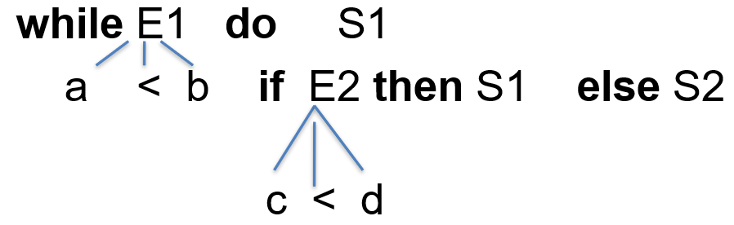
Derivation
while a < b do
if c < d then
x : = y + z
else
x : = y - z

Slide 29
Explanation
E1.code – if a < b goto true label
goto false label
True label is the body of the while
False label is the S.next
E2.code – if c < d goto true label
goto false label
while a < b do
if c < d then
x : = y + z
else
x : = y - z

Slide 30
Explanation
This should be done in the context of while and if-else
If then else
S.code := E.code || gen (E.true’:’) || S1.code || gen (‘goto’ S.next) || gen (E.false :’) || S2.code
While do
E.false = S.next
S1.next := S.begin
S.code := gen (S.begin ‘:’) || E.code ||
gen (E.true’:’) || S1.code ||
gen (‘goto’ S.begin)

Slide 31
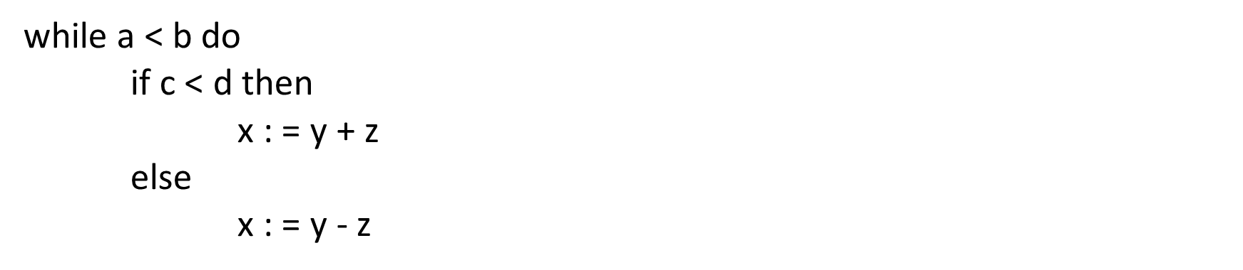
Code
L1: if a < b goto L2
goto Lnext
L2: if c < d goto L3
goto L4
L3: t1 : = y+ z
x := t1
goto L1
L4: t2 := y – z
x := t2
goto L1
Lnext:

Slide 32
Summary
Control flow statements
If-then, if-then-else, do-while
Boolean expressions with control flow
Incorporating short circuit code in generating 3-address code

